Slide 1
Ramallah Dental Clinic
Done by : Jana Herzallah 1201139
Nirmeen Al-Sheikh 1200200
Lana Badwan 1200071
Roaa Ghannam 1200353
Noor Hamayel 1202853
Supervised by : Dr.Samer Zain

Slide 2
Current System Problems
Inefficient Reporting Mechanism:
Current system for generating reports related to patients, doctors, nurses, appointments, and inventory is weak and ineffective.
Communication Challenges:
Verbal and oral communication between doctors and staff about inventory issues is not efficient.
Appointment Booking Process:
Patients need to call receptionists to book appointments.
Doctors and employees manually create schedules, leading to challenges in emergencies and appointment cancellations.
Manual Record Keeping:
Doctors manually record patient data, including diagnoses, medications, operations, X-rays, and blood works.
Current method involves maintaining data in large folders, making it vulnerable to loss and corruption.

Slide 3
Payment Tracking Complexity:
Lack of automated system to link patients' bank accounts and insurance policies.
Difficulty in tracking payments manually, especially for installment plans and insurance coverage.
Discounts and Family Billing:
Proposal to implement a system for linking patients' accounts and insurance policies to simplify payment tracking.
Plan to provide family discounts through the system, eliminating the need for complex manual calculations.

Slide 4
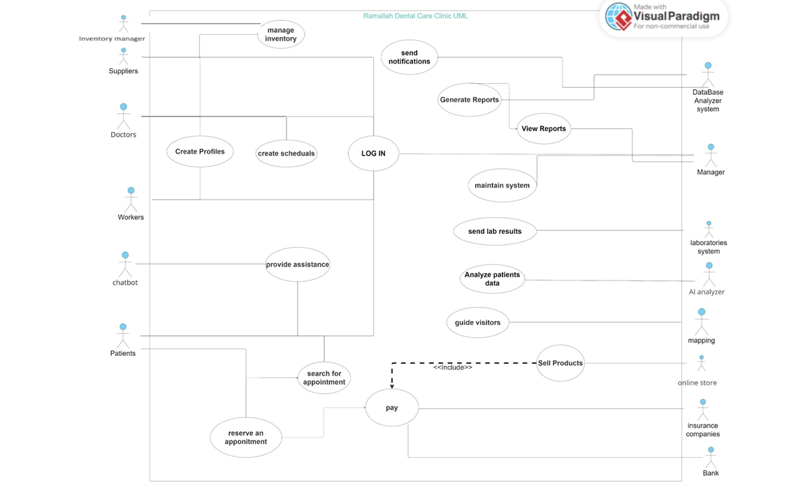
Use Case Diagram

Slide 5
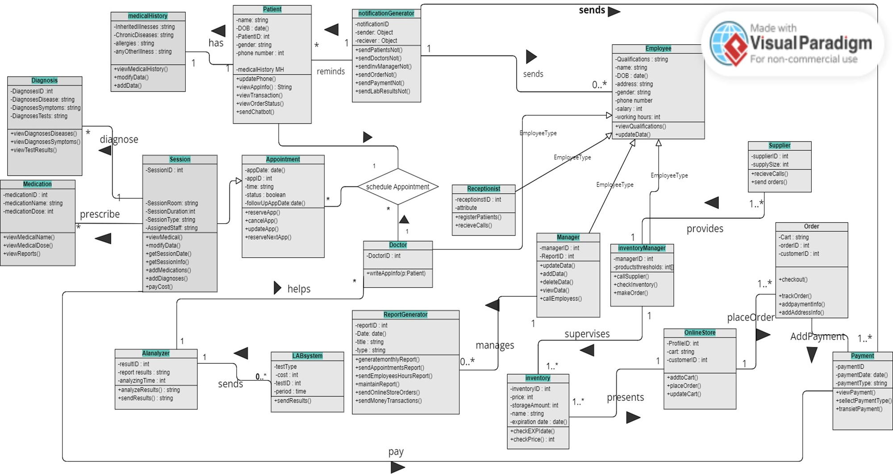
UML Class Diagram

Slide 6
List of smart features:
1. Create profiles: The system allows all employees in the clinic (doctors, workers, recipients, secretaries, Sales representatives) and patients to create their individual profiles by providing their essential information such as name, ID, contact details, role, qualifications, family members, bank accounts, insurance, .. etc. The software creates a profile page for each employee and patient that contains their general personal and professional information. Also, it gives employees and patients the option to update his data as needed.
2. Log in: Each employee and patient has his own account and can log into it with his credentials to ensure his data security and privacy, the process starts when users get to the login page and enter their usernames and passwords, the entered credentials are sent to database analyzer actor for validation. The system checks if the provided data matches the records in the database, so if it is valid the user is authenticated and his identity is confirmed.

Slide 7
3. Workforce Scheduling: This functionality is designed for the clinic's administrative team. It facilitates the creation and management of comprehensive work rosters for all clinic personnel, including medical and auxiliary staff. Key capabilities include shift planning, task assignment, schedule adjustments, and timely communication of any roster changes to the relevant individuals.
4. Reserve an appointment: In this case, different actors as patients can pick a time to see a doctor and confirm it. It's linked to both looking for open slots and paying, which means patients can find, book, and possibly pay for their appointments all at one time.
5. Manage inventory: System allows inventory manager to maintain essential supplies and devices used in the clinic, the staff receives automated reminders and notifications when a particular supply falls below a defined and known threshold, the system depends on the historical data to help in tracking the performance and lifespan of the supplies and devices.

Slide 8
6. Generate reports: DataBase analyzer system is responsible for generating reports at the end of each month including reports about employees and their working hours details. It will also report the amount of money spent and gained in that month to send to the manager
7. View reports: Monthly reports will be viewed and sent by the database analyzer to the system manager in order to study the performance of each employee and the number of patients they have been treated. Also, the bills and revenue and how exactly the money was gained.
8. Pay: This transaction outcome goes to banks or Insurance companies after reserving an appointment from different actors, such as patients and workers, or after buying products from the online store.

Slide 9
9. Send notifications: This part is one of the major roles in the system, it is connected with a database analyzer system that will remind patients about their scheduled appointments on their accounts, and doctors with their schedule also it will send inventory managers notifications when the inventory falls down and let them know that they need to restock. It's also connected to the payment class so that any operation will notify the user’s profile.
10. Sell Products: Online store is dedicated to present recommended products to patients by their doctors so that they can provide them with the high-quality products that will help with the treatment and also increase the profits gained by the clinic.
11.Product Management and Sales: This feature empowers sales team members to oversee an online marketplace specifically for dental care products. It simplifies the processes of product listing, order management, and transaction processing, thereby enhancing the shopping experience for patients.

Slide 10
12. Send lab results: Doctors and nurses take blood samples from patients and send them to Laboratory, then does the test, generates the reports, sends them back to the system of the clinic, and saves it in the patient folder so that doctors can access them.
13. Analyze patients data : The AI tool offers dental professionals tools for creating custom treatment plans. Also, analyzing medical images and blood tests to diagnose them, so that way it can help with processing and summarizing patients data hence, doctors can faten their work and efficiency.

Slide 11
14. Clinic Access Map: A clear and concise map guiding patients directly to the dental clinic from various common starting points, ideal for new visitors and those unfamiliar with the area.
15. Disabled people help : doing a version that helps blind people by interacting with the software through voice notes
16.Emergency interfaces in the app: calling numbers provided in this section will connect patients to specialized doctors with emergencies handling doctors.

Slide 12
Non Functional Requirements:
Reliable
Since the current system you are dealing with gets down, especially when lots of demand happens on the system, we ensure that our presented system will be reliable by using infrastructural facilities. Starting with the data servers holding data and offering services, we can ensure that they can hold users at the same time up to the number of all users created on the application by this current time plus the number of expected users till 7 years ahead so that the system can be prepared till long time coming, which we can take from your departments by looking at the numbers of patients attending your clinic year by year.

Slide 13
2. Secure
Then, moving to the most important feature, which is keeping the data secure, we can ensure that by subscribing to cloudflare, which provides a secure and trustworthy security system through:
SSL/TLS Encryption:
Cloudflare offers SSL/TLS encryption for secure communication between users and websites, ensuring data privacy and integrity.
Load Balancing:
Cloudflare's load balancing services distribute incoming web traffic across multiple servers to ensure optimal performance and prevent server overloads.

Slide 14
3. Dependable :
Data Backup and Recovery:
Requirement: The clinic system must implement regular and automated backups of critical data, including patient records, appointments, and inventory information.
This ensures that in the event of system failures, data loss, or other unforeseen incidents, the clinic can recover information from a recent backup, minimizing downtime and maintaining data integrity.
Autosaving of User Input:
Requirement: The clinic system should implement auto saving functionality for user inputs during data entry or form completion.
Autosaving ensures that in case of system crashes, power outages, or accidental closures, users do not lose their work, contributing to a more seamless and user-friendly experience.

Slide 15
4. Ethical and Legal Requirements:
Ensure compliance with healthcare data protection laws, including patient confidentiality and privacy regulations.
Implement ethical data handling practices, securing sensitive information and ensuring patient consent for data usage.
5. Usable for all peoples ages and backgrounds
The system's usability requirements emphasize the need for clarity, cleanliness, and consistency in the user interface. All interfaces must offer straightforward navigation, ensuring users can easily access features. Customization options will be available, and Figma will be used for UI/UX design, promoting a visually appealing and cohesive user experience. The goal is to create an intuitive system that minimizes steps for common tasks, incorporates responsive design, and encourages user feedback for continuous improvement.

Slide 16
Use Case Specification For Each Member
Employee Registration use case specification
Brief Description
This use case shows the employee registration and information management system, specifically for managers to facilitate the initiation of employee registration. The system enables managers to create initial profiles for the new employees by adding their main details such as name, department, and job title.
2. Flow of Events
The procedure begins with managers using the Employee Registration and Information Management System, which is designed to facilitate employee registration.
Basic Flow - Manager-Initiated Initial Profile Setup:
Managers log into the Employee Registration and Information Management System to initiate the registration process for adding a new employee.

Slide 17
2. Within the system, managers navigate to the "Initial Profile Setup" section, where they create preliminary profiles for each new employee.
3. The manager enters the main information, including the employee's full name, proposed position, departmental allocation, and other essential employment details.
4. The system prompts managers to review and confirm the accuracy and completeness of the entered information for the employee to finish the initiation account registration.
5. The system automatically notifies the manager upon the successful completion of the initial profile creation.
6. Employees get a notification after the manager ends their registration.‎ 7. Employees fill in their personal and job-related info, birthdate, gender, ‎contacts, emergency contacts, work history, skills, qualifications, and a photo.‎

Slide 18
8. After employees finish entering their information, the system checks to make sure all info is completed and ‎entered correctly.‎
9. Both the employee and manager get a notification when everything is good, confirming that ‎the registration is done, and the profile is completed.‎
2.2 Alternative Flows
2.2.1 Missing employee information:
If mandatory personal or medical information is missing during the registration process:
1. The system notifies the employee to verify and complete their profiles by adding the required information and all their details to the system.
2. Employees are prompted to complete all their information to complete their profiles.

Slide 19
2.2.2 Existing employee
Within the register process, if the system detects an existing employee with identical identification and information, an error message will occur, indicating "Employee Already Exists." The manager has three options: to modify the employee's details, delete the existed account and generate a new one with the new employee information, or cancel the operation.
2.2.3 Update Employee Information:
1.‎ Employee can update his profile by selecting "update information."‎
‎2.‎ The System displays the current employee information to edit.‎
‎3.‎ Employee choose to edit his specific information such as date of birth, telephone number and qualifications.‎
‎4.‎ System checks the entered information if it is entered correctly and there is no missing.‎ If all the entered new data are correct and accurate, information is updated.‎
‎5.‎ If not, notify the employee to edit the entry until all required data is correctly entered.‎

Slide 20
3. Special Requirements
1. The system must implement strong encryption algorithms for employee data transmission and storage.
2. The registration process should be user-friendly, with clear instructions and intuitive interfaces that all employees could find it easy to use despite their knowledge and skills.
4. Entry Conditions
4.1 Log In
Before the employee adds his information to complete his profile, the manager must have completed the initial employee registration and profile setup in the Employee Registration and Information Management System. This involves entering key information such as the employee's full name, proposed position, departmental allocation, and other essential employment details during the initial profile setup by managers. Additionally, the manager should ensure that the employee has successfully logged into the system following the registration process.

Slide 21
5. Exit Conditions
5.1. Log out
Secure preservation of employee registration information ensures that all of his data, including personal and professional information, is securely preserved, and when the employee logs in again into the system, he will resume where he left off If the employee wishes to log out and continue entering his information later.

Slide 22
2. Patient Registration use case specification
1. Brief Description
This use case allows patients who are at clinic to create an account with the Clinic app, which they can use for registration. In order to ensure the confidentiality of patient data, an input of essential information such as names and medical details is requested. The primary actor in this use case is the patient.
2. Flow of Events
The use case begins when the user selects the "Register as patient" activity from the Main Form.

Slide 23
2.1 Basic Flow – Patient Registration
1. The patient selects "Register as patient" activity.
2. The system directs the user to the patient registration interface.
3. Patient inputs the following personal information: full name, date of birth, gender, contact details, emergency contacts, and provides a photograph for identification purposes.
4. Patient enters additional medical information, including: Chronic diseases and drug allergies.
5. The system store the provided data in the database.
6. User receives clear instructions and step-by-step guidance throughout the registration process.
7. The system validates the entered information for completeness and accuracy.
8. If mandatory medical information is incomplete, the system suspends registration until the missing data is provided.
9. Upon successful completion, the system confirms registration. And a notification message sent to the patient's contact.

Slide 24
2.2 Alternative Flows
2.2.1 Incomplete Information:
If mandatory personal or medical information is missing during the registration:
1. The system notifies the user of these missing data.
2. The mandatory fields are required to be filled in by the patient.
2.2.2 Update Information:
1. "Update information" is selected by the patient.
2. The patient's current information is displayed in the system for review.
3.The patient can choose to edit some of the fields listed below, for example, contact information, emergency contacts.
4.The system will validate the information entered after patient edit it.
5. If everything is correct , the information shall be updated properly.
6.If not, retry the update process to ensure that all requested data are correct.

Slide 25
2.2.3 Registration Suspension:
If the patient decides not to proceed with registration:
1. The system suspends the registration process.
2. The patient is redirected to the Main Form.
2.2.4 Confirmation Review:
After completing the registration, the system provides a confirmation screen.
1. The patient can review all entered data for accuracy..
2. If everything is correct, the patient confirms the registration.
3. If not, the patient can choose to edit specific fields.
2.2.5. Notification Preferences:
If the patient wishes to customize notification preferences:
1. Notifications preferences, such as reminders of appointments or health updates, are available within the system.
2. Patient selects preferred notification settings.

Slide 26
2.2.6 Confirmation and Notifications:
Upon final confirmation of registration and notification preferences:
1. The system will send a message of confirmation to the patient's contacts.
2. The application displays notifications about successfully registered users.
3. Special Requirements:
The registration process should be user-friendly, with clear instructions and intuitive interfaces.
4. Entry Conditions:
For this use case, there is no entry condition. The first step after the application has been downloaded is this use case.

Slide 27
5. Exit Conditions:
5.1. log out:
After logging out, all registration information must be securely saved. This includes the patient's details and any information that is filled in during the registration process. This ensures that the next time the patient logs in, he can smoothly return to where he stopped in the registration process.
5.2. Track Registration Progress
Patients will be able to track their progress in the application after completing the registration. This feature will allow them to keep an eye on the status of their registration and be able, when they log in again, to proceed with incomplete steps.
5.3. Feedback and Reviews
Patients may provide feedback and write reviews of their experience with registration after being successfully registered. This function can help improve the process for registering an application, as well as improving user satisfaction with its services in general.

Slide 28
“Shop An item” Use Case
Brief Description
This use case allows the customer registered in the application to shop through the online store which is dedicated to the clinic. This includes searching for items, adding items to the cart, and checking out the order.The actor for this use case is the Shopper who is the user of the App which could be an employee or a patient or anyone with a profile on the App.
2. Flow of Events
The use case begins when the user selects the "SHOP ONLINE" activity from the Main Form.
2.1 Basic Flow – Scroll through randomly suggested items
1. When the shopper first selects “shop online “from the main form the system will show a randomly suggested items of the products that the clinic provides.
2. The system will have the suggested items appearing in the screen as pictures with the title of the name of the item under it and the price in shekels next to the name too.
3. The shopper can scroll through the items and pick any of them to view the details of it.
4. The system will show multiple pages of the suggested items.

Slide 29
2.2. Alternative Flows
2.2.1 Search for An Item
1. The Shopper selects "search for an item”.
2. The Shopper writes the name of the product to look for.
3. The system displays a screen of variety of items that matches the searched one with the price and a name of the item within a picture of it.
4. The Shopper can scroll until all items with matched results of the search ends.
5. The Shopper can select any item to see its details.
6. The system will display a screen when the shopper selects an item letting the user to read reviews and see pictures of the item.
7. The Shopper has an option to select “add to cart” directly from this screen if he/she wants to proceed and the system will display another screen explained in 2.2.1.
8. The Shopper can navigate back to the search results screen.

Slide 30
2.2.2 Add to Cart
1. The Shopper selects "add to cart" option after selecting an item.
2. The system updates the shopper’s cart by adding the picked item to it.
3. The system notifies the Shopper that the cart has the selected product and its price.
4. The system gives the Shopper two options of either checking out or navigating to the past search results screen that presents items to continue shopping.

Slide 31
2.2.4 Product Is Out of Stock
If in the "search for an item" sub-flow the system finds that the product is out of stock. A notification message will be displayed to the shopper of when it will be in stock again by doing a query on the database analyzer and the shopper can select the option of receiving a message when its restocked again. The shopper can navigate back to the “search for an item” and search for another item and proceed with shopping or just get out of the app until the item is restocked again.
2.2.5. Product is not found
If in the "search for an item" sub-flow the system finds that the product is not provided. A notification message will be displayed to the shopper that will tell the shopper that it doesn’t exist in the store. And the system will send the manager a report having the date and the product not provided so that the manager can consider providing in the future. The shopper can navigate back to the “search for an item” and search for another item and proceed with shopping or just get out of the app until the item is restocked again.

Slide 32
3. Special Requirements
1. When searching for an item, the system shall respond within 4 seconds.
2. The process of requesting a query on the database analyzer for when a product will be in stock again shouldn’t take more than 5 seconds.
3. The system regularly backup shopping and user information to prevent data loss in case of system failures.

Slide 33
4. Entry Conditions
4.1 Log In
Before this use case begins the shopper must have finished setting his profile on the App and have logged into the system.
5. Exit Conditions
5.1. Log Out
After the shopper logs out, all shopping info must get saved; cart and information filled so that the next time the shopper logs in to return to where the shopper stopped.
5.2. check out items
If the shopper is done shopping, he has to do two things before confirming his order which are filling Payment info and his/her address info.

Slide 34
4. Management Inventory use case specification
Brief Description
This use case allows the Inventory Manager to maintain inventory information in the system. This will include to add any inventory with details, searching of exist item, update any inventory information.
The main actor of this use case is the Inventory Manager, who will use the app to maintain inventory.
2. Flow of Events
The use case begins when the Inventory Manager selects the "Maintain Inventory" activity from the Main Form.

Slide 35
2.1 Basic Flow – Add Inventory
1. The Inventory Manager selects "Add Inventory."
2. The system displays a blank inventory form.
3. The Inventory Manager enters the following information for the inventory: code, name, purchase date, expired date, quantity, then selects “save” option.
4. The system validates the data to insure the proper format and searches for an existing inventory with the specified code. If the data is valid the system creates a new inventory.
5. Steps 2-4 are repeated for each inventory added to the system. When the Inventory Manager is finished adding students to the system the use case ends.

Slide 36
2.2 Alternative Flows
2.2.1 Modify Inventory
1. The Inventory Manager selects "modify inventory."
2. The system displays a blank Inventory form.
3. The Inventory Manager types in the code or name of inventory to modify.
4. The system retrieves the inventory information and displays it on the screen.
5. The Inventory Manager modifies one or more of the inventory information fields code, name, purchase date, expired date, quantity.
6. When changes are complete, the Inventory Manager selects "save."
7. The system validates data, then updates the inventory information.
8. Steps 2-7 are repeated for each inventory the Inventory Manager wants to modify. When edits are complete, the use case ends.

Slide 37
2.2.2 Order Inventory
1. The Inventory Manager selects "Order new Inventory."
2. The system displays a blank inventory form.
3. The Inventory Manager types in the inventory information: code, name, purchase date, quantity to save the order.
4. The system retrieves the inventory and displays the inventory information in the form.
5. The Inventory Manager selects "Order."
6. The system displays a order verification dialog confirming the order operation.
7. The Inventory Manager selects "yes."
8. The system send notification to the supplier with order information.
9. Steps 2-8 are repeated for each inventory to order from the system. When the Inventory Manager is finished ordering inventory to the system the use case ends.
2.2.3 Inventory Already Exists
If in the "Add Inventory" sub-flow the system finds an existing inventory with the same name an error message is displayed "Inventory Already Exists" and displays the certain quantity of the inventory. The Inventory Manager can either update the exist inventory, create a new inventory with the same name or code, or cancel the operation at which point the use case ends

Slide 38
2.2.4 Inventory Not Found
If in the "Modify Inventory" or "Order Inventory" sub-flows the inventory code is not located, the system displays an error message, "Inventory Not Found". The Inventory Manager can then type in a different code/name or cancel the operation at which point the use case ends.
3. Special Requirements
1. The system retrieves the student record in no more 3 seconds when search for an inventory.
2. System sends notifications to Inventory Manager when any inventory is near to finish.
3. System has high security when login into Inventory system, it sends email to Inventory Manager about any log in try.

Slide 39
Entry Conditions:
4.1. Log In: Inventory Manager has to login into system to start the use case.
5. Exit Conditions
5.1. Log out: After Inventory Manager log out, all information and modifications will be saved in the database.
5.2. Track orders: After the Inventory Manager log out from the system, system will send report to Inventory Manager account about all modifications happened.

Slide 40
5.AI Tool for Dental Diagnostic use case specification
Brief Description
This use case explains how an AI tool evaluates blood tests and dental X-rays to provide patients and dental professionals with diagnosis and treatment recommendations.
Flow of Events
The use begins when a dental professional or patient begins the "Dental Diagnostic Analysis" process within the AI system.

Slide 41
2.1 Basic Flow-Diagnostic Analysis and Reporting
The Registrar selects "Start Analysis".
The system asksthe user to upload dental images and blood test results.
The user uploads the required medical files into the system.
The system performs a preliminary check to ensure that the image quality and file types are suitable for analysis, then uses artificial intelligence (AI) algorithms to analyze medical data and produce a diagnostic report.
The system sends the user a notification as soon as the report is complete.
Once the user has successfully obtained and reviewed the report, the use case is over.
2.2 Alternative Flows
2.2.1 Update data
The Registrar selects "Data Management" and then chooses the "Update data" option.
The system shows a list of data files that have already been uploaded.
The user selects the data file that requires updating, and uploads the updated dental pictures or blood test results.
The system verifies the format and quality, then it processes the updated data using the AI algorithms for re-analysis.
The user is notified when the revised report is prepared for review and the new analysis is finished.
When the user examines the revised diagnostic report, the use case is over.

Slide 42
2.2.2 Data Deletion
The Registrar selects "Data Management" and then chooses the "Delete Data" option.
The system presents a list of all previously uploaded data and provides a search function.
The user selects the desired data to be deleted after it has been located.
The system asks the user to verify that they really want to remove the chosen data, then deletes it after confirmation.
A notification confirming the successful deletion is sent to the user.
The use case ends when the user exits the data management section.
2.2.3 Review Past Reports
The Registrar selects "Data Management" and then chooses the "Review Historical Reports" option
The system displays a list of all past reports and provides a search function.
The user selects the preferred report from either the complete list or the filtered list.
The system retrieves and presents the chosen report for an in-depth examination.
The use case ends when the user has finished reviewing and exits the report section.

Slide 43
2.2.4 Unclear Image Resubmission
When an image uploaded for analysis is inadequate, the system alerts the user, who then re-uploads a clearer image. After verifying the new image's quality, the system conducts the analysis, ensuring accurate and reliable results from the AI tool.
2.2.5 Inadequate Blood Test Data
The user is notified when the system deems blood test data insufficient and requests that they submit a more thorough blood test. To guarantee accurate diagnostics, the system then reanalyses the data using the updated information.

Slide 44
3. Special Requirements
Respect patient privacy and data encryption by following HIPAA guidelines.
For image analysis, diagnostic results should be produced in no more than 10 seconds, and for treatment planning, in no more than 5 seconds.
4. Entry Conditions
The patient or dental professional using the system needs to log in to access the system.
5. Exit Conditions
The process ends with the generation and access of a diagnostic report.

Slide 45
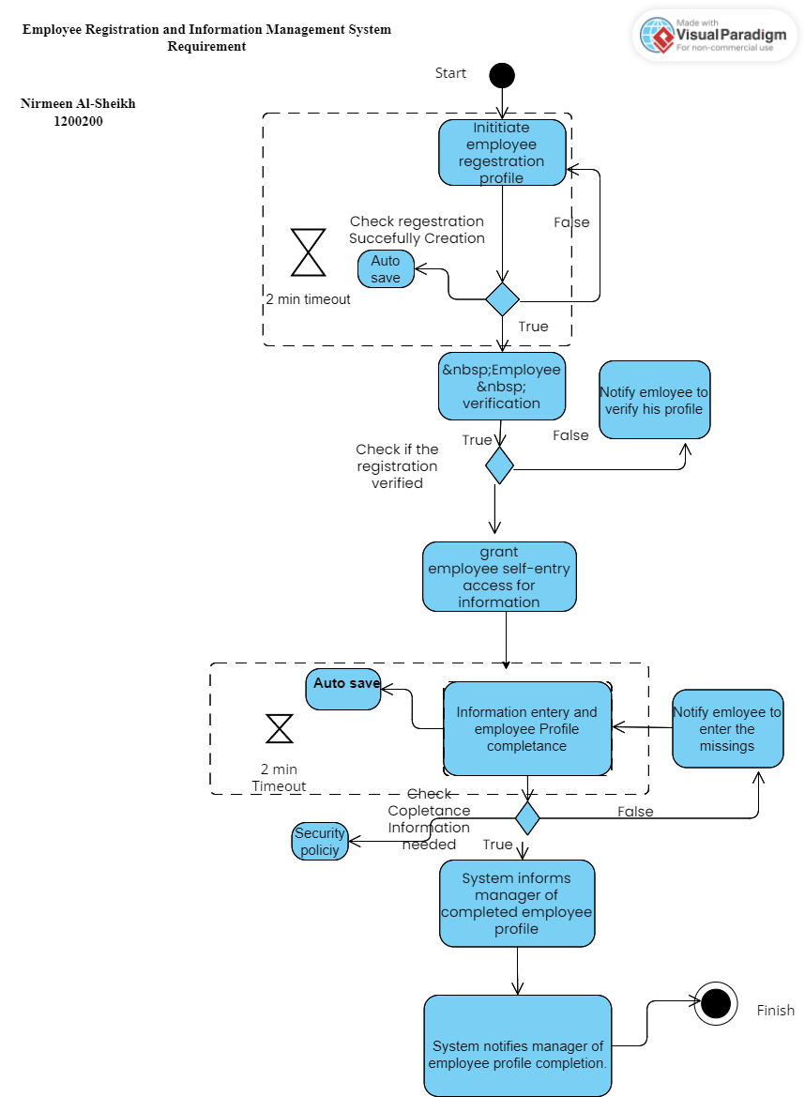
Activity Diagram for Each Member
Employee Registration activity diagram

Slide 46
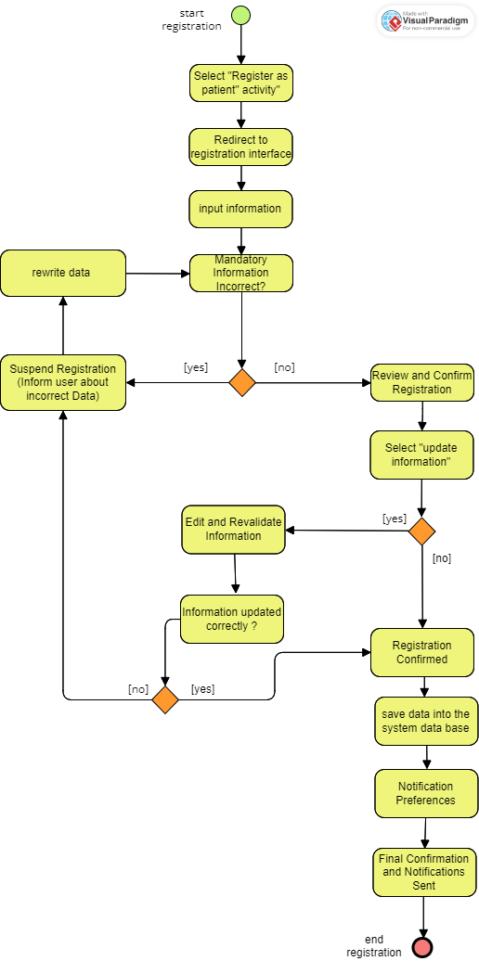
2. Patient Registration activity diagram
A step by step workflow for the patient registration system is described in this activity diagram. The process shall begin when the user chooses to register as a patient and selects this option. The user is then guided to the registration interface, where they enter their information.
The correctness of the required information shall then be checked by the system. The process will suspend registration in case of incorrect data so that the user can rectify and resubmit it. If this information is correct the process moves to the review and confirm registration phase. By clicking the "update information" option, users are able to modify or refresh their data at any time.
The system checks the accuracy of the updated data and, if correct, proceeds to Registration Confirmed; otherwise, it loops back for further editing. Once confirmed, the patient's data will be safely stored in the database. Then users are prompted to specify their notification preferences and final confirmations will be issued in accordance with those preferences. The entire registration process is completed by the notification system, indicating the successful completion of the registration process.

Slide 47
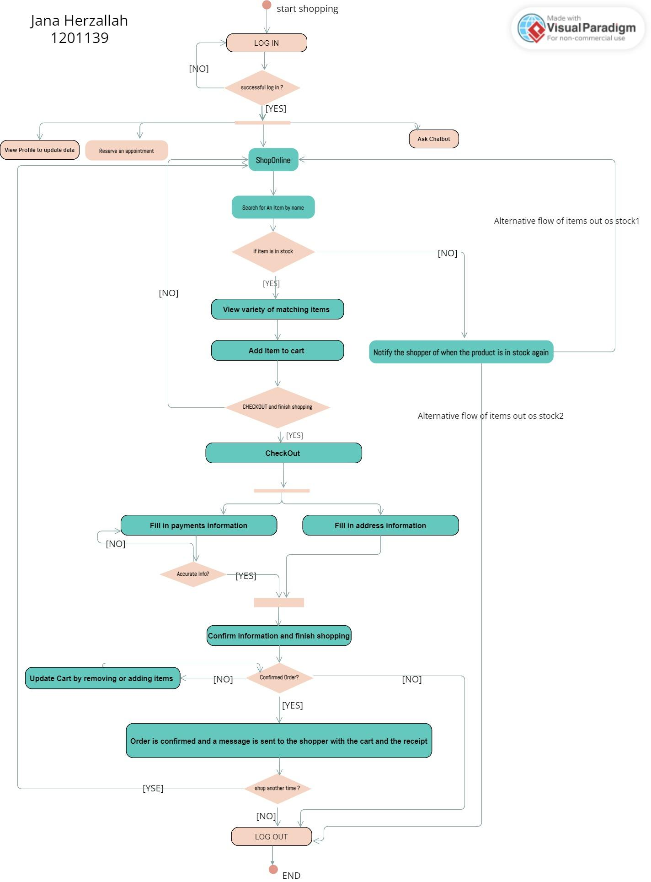
3. Shop an item activity diagram

Slide 48
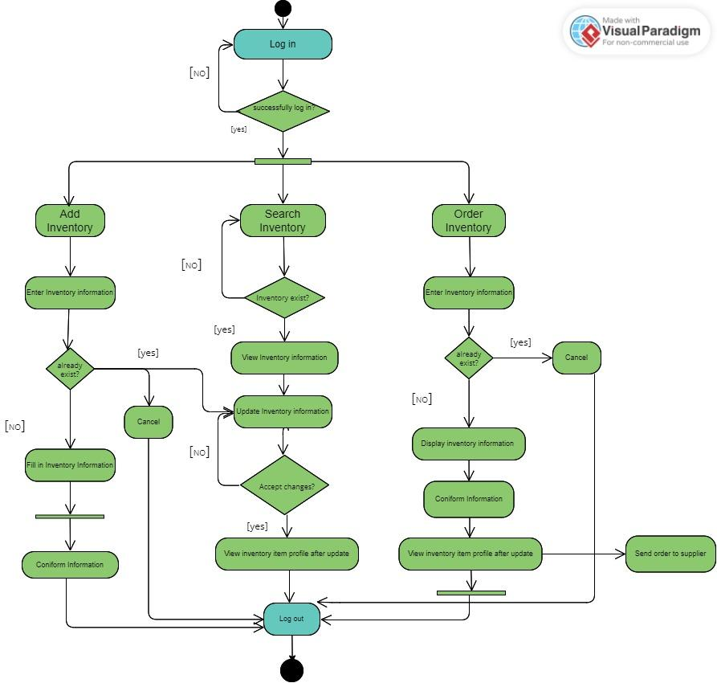
4. Management Inventory activity diagram

Slide 49
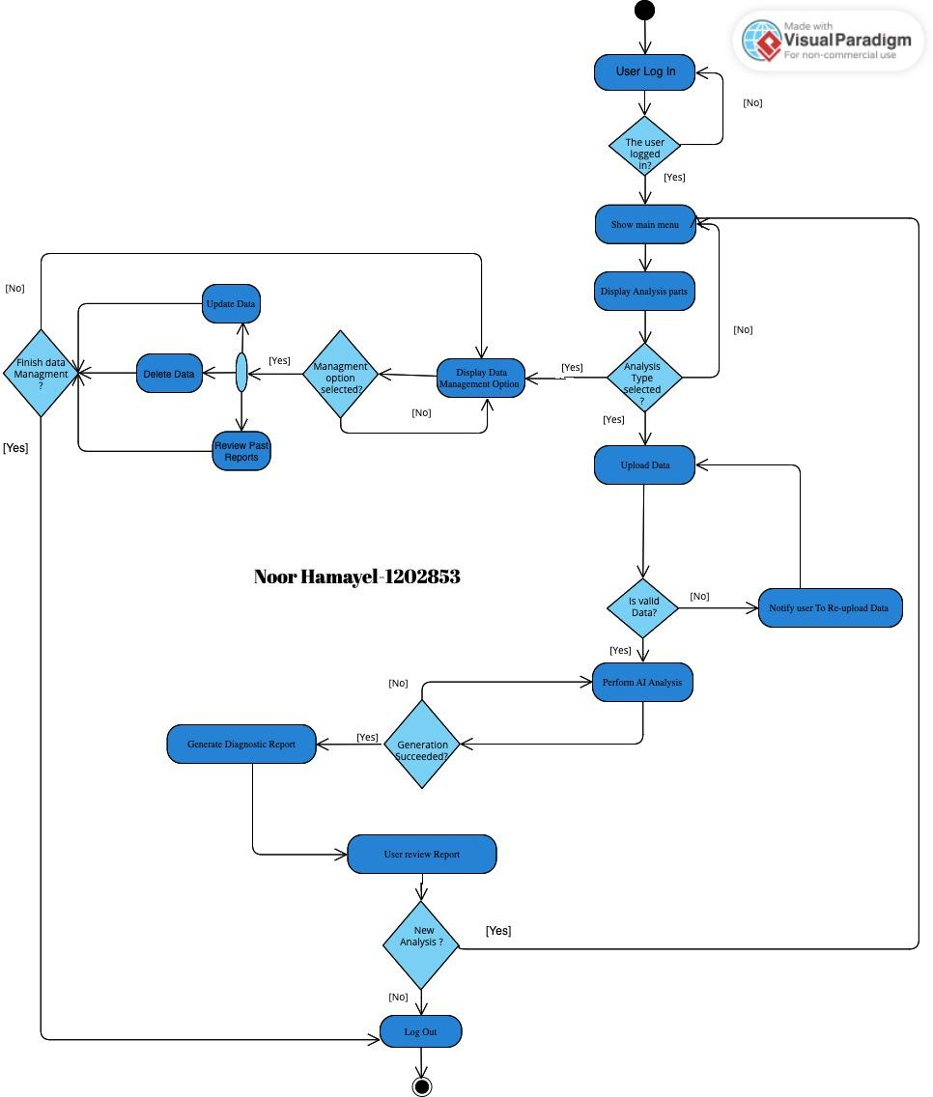
5.AI Tool for Dental Diagnostic activity diagram

Slide 50
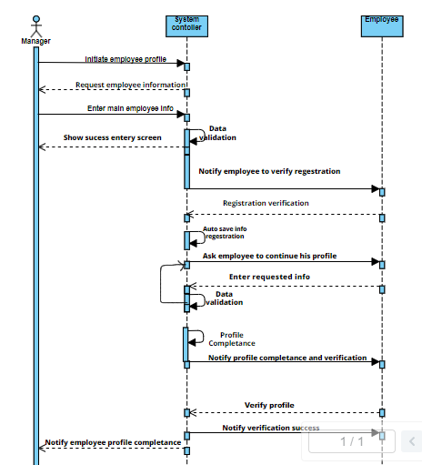
Sequence Diagram for Each Member
1.Employee Registration sequence diagram

Slide 51
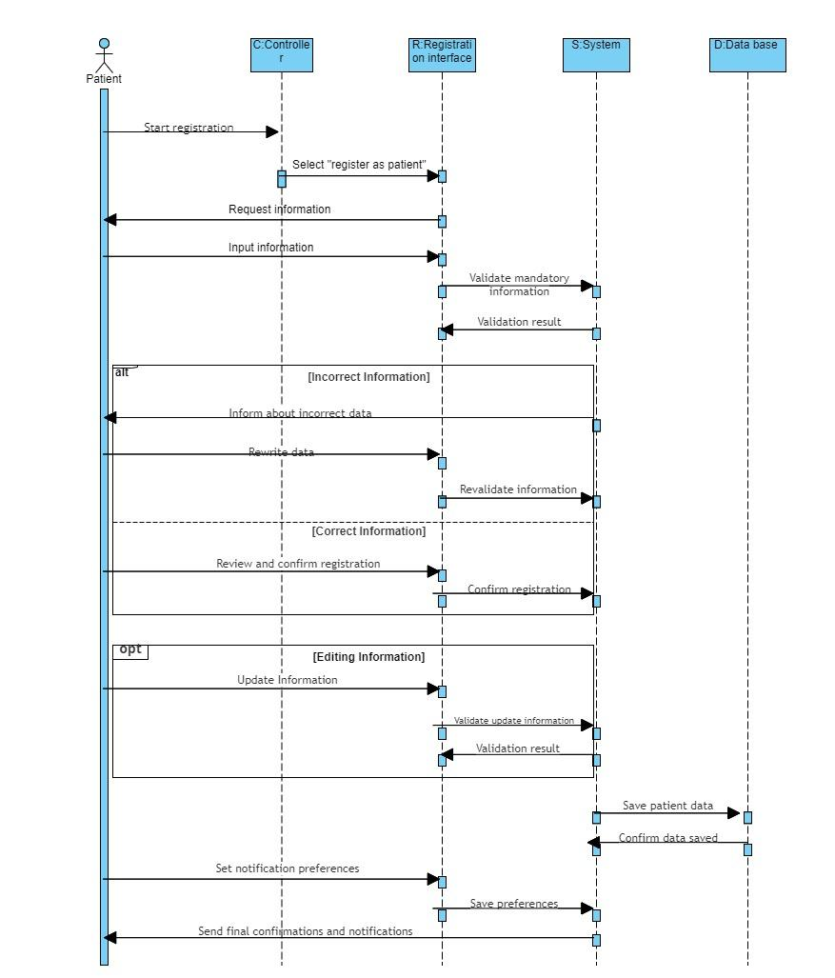
Patient Registration :
2. Patient Registration sequence diagram
Time

Slide 52
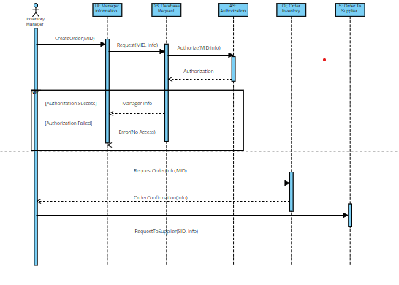
Order an Inventory

Slide 53
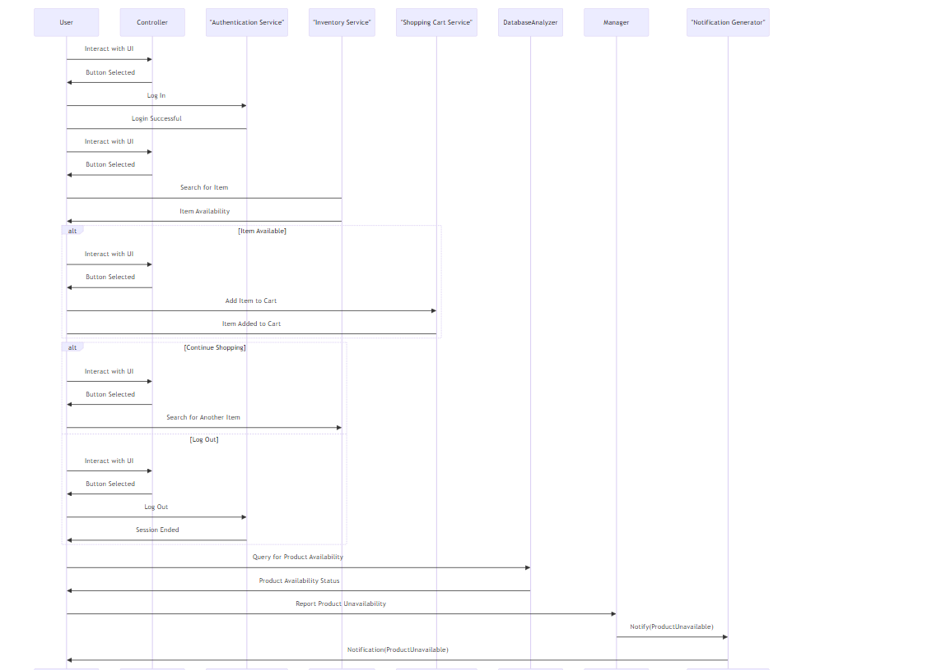
3. Shop an item sequence diagram

Slide 54
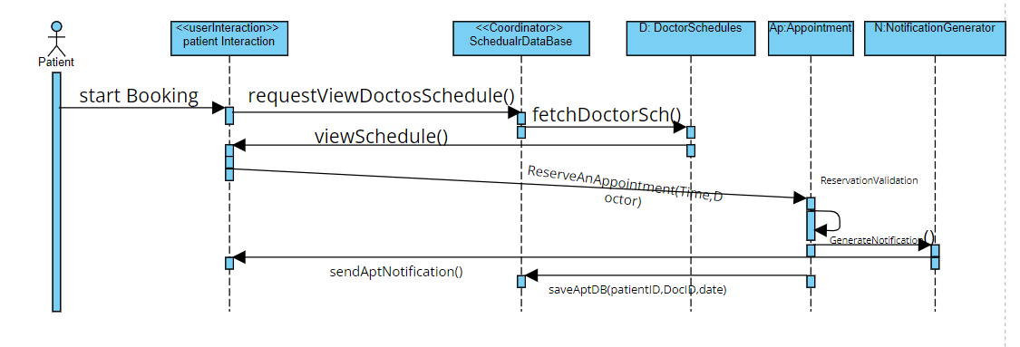

Slide 55
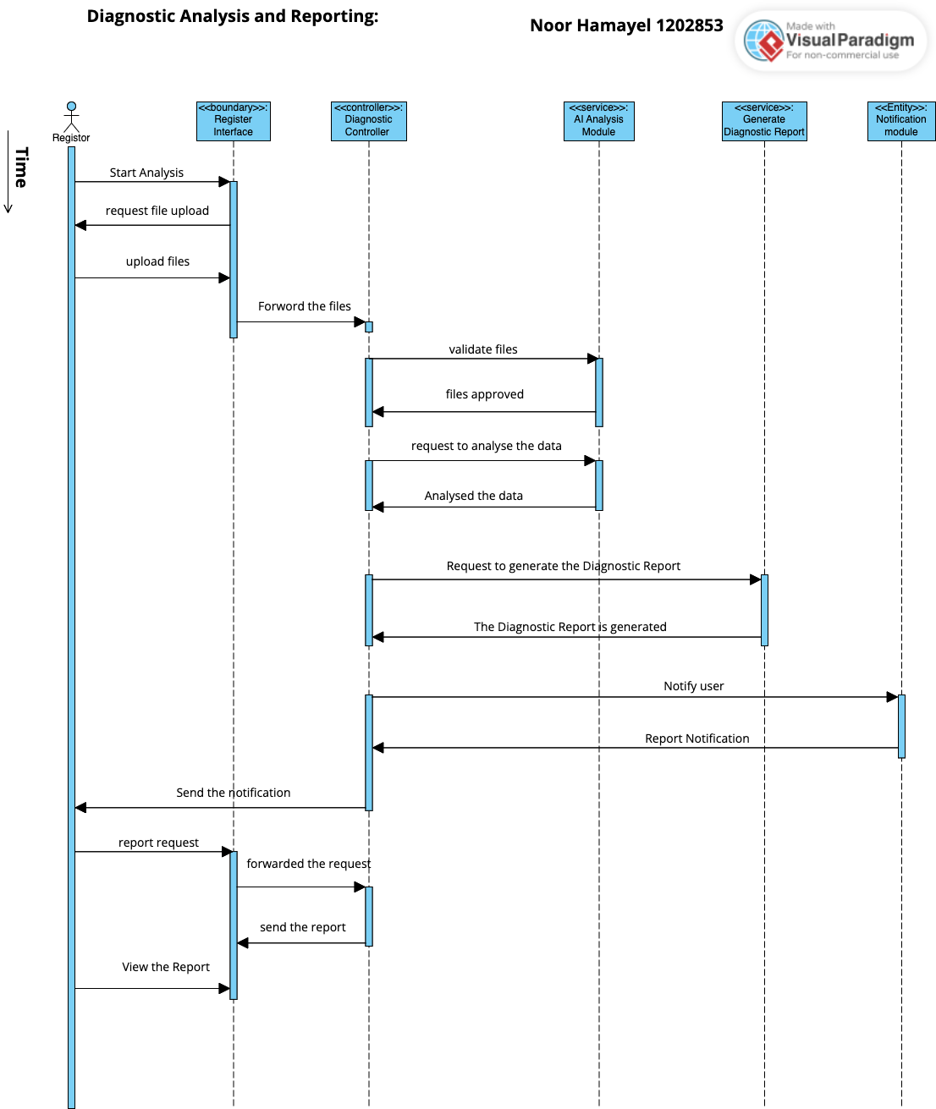
5.Diagnostic Analysis and Reporting

Slide 56
Thank you!

